Slide 1



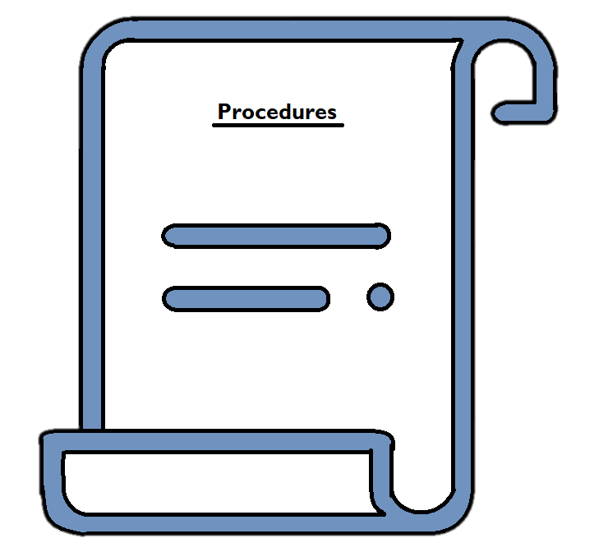


















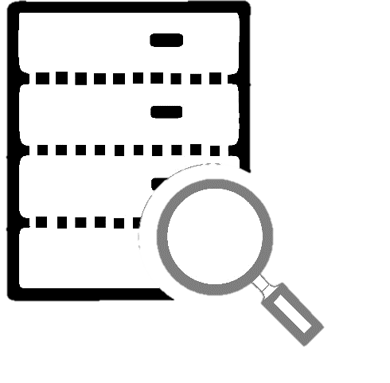




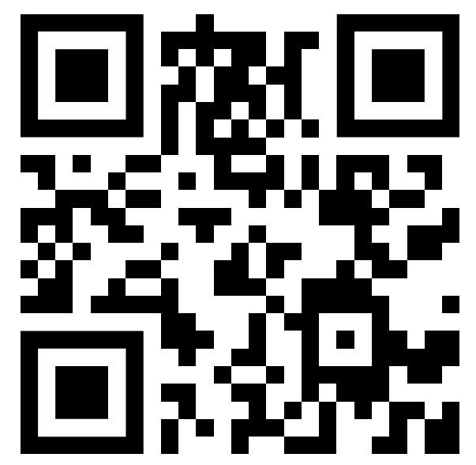
Streamlining Cloud Platform Document Migration:
Migration Tool Enhancement
About DoxAdvisors and Project:
DoxAdvisors is a boutique systems integrator that specializes in document management for law firms. DoxAdvisors' expertise and premier partnerships with leading cloud-based document management systems (DMS), NetDocuments and Worldox, have led to significant growth as the legal industry transitions to digital solutions.
With our unique suite of tools and assets enables clients to migrate seamlessly from Worldox to NetDocuments, DoxAdvisors is well-equipped to help thousands of clients with their migrations.
With the recent acquisition of Worldox by NetDocuments, the project Migration Tool Enhancement has been initiated with the goal of improving remote work capabilities, security, and compliance.
Project Goals
Minimize procedural errors | Improve migration efficiency | Improve client experience
Project Activities
Procedure documentation
and video creation
Simplify and refractor existing processes
Extend capabilities of existing tools and scripts
Project Outcomes
Client
Client
Document procedures for various migration formats. Prepared for video recording or review usage.
Through script testing, error analysis and unification of processes. a more streamlined and efficient migration process, with reduced errors and increased functionality
DoxAdvisors
Project Significance & Benefits
Integrated and refactored scripts assist the primary migration processes in reaching new milestones.
Enhancing client experience in NetDocuments with improved efficiency and error handling.
Worldox
Platform
Document Migration
Team
NetDocuments
Platform
Reduction in workload and improved project delivery rates.
Obtaining first-hand experience in performing client migration projects and validating their effectiveness is essential to achieving project objectives. Incidentally, this drives the completion of project.
Project Stakeholders
Clients:
Primary beneficiaries of the project.
As professionals from legal fields, they trust their documents with DoxAdvisors and rely on our processes to ensure a seamless and efficient migration between platforms.
Documentation builds the foundation for clarity and apprehension of protocols.
Detailed and succinct recordings will serve as a basis for training and developing further learning materials.
NetDocuments:
As a cloud document management platform, NetDocuments is crucial in the success of DoxAdvisors.
With its robust features and tailored solutions for the legal industry, DoxAdvisors develops procedures to efficiently migrate documents between platforms with integrity, ultimately benefiting our clients.
DoxAdvisors Migration Team:
A key stakeholder in the project initiative.
Utilising expertise and experience in handling complex migration procedures. The team ensures that the project meets its goals and milestones. Ultimately leading in a better migration experience for the team and customers.
Project Deliverable: Script Analysis
Project ‘SQuirreL’, a separate ongoing project to unify all scripts to a SQL format.
With goals similar to this project, scripts of different formats (SQL, PowerShell & batch) are examined, configured and integrated into SQL scripts. In particular, attention was given to enhancing the dynamic nature of the scripts to facilitate future modifications.
Prospects in Future Project Development
Video Guides on Document Migration Processes:
Working in conjunction with the written documentation from this project. This task requires a high level of understanding of tools and code used and their risks to properly demonstrate migration protocols visually.
Project Deliverable: Legacy Files Processing
Migration procedures for legacy records are distinct from general documents.
In collaboration with the migration team, specific protocols and scripts are devised for handling legacy files. These are thoroughly reviewed, tested, and then implemented for client files.
Client Satisfaction Following Document Migration:
To enhance user experience beyond migration procedures, we require a comprehensive understanding of NetDocuments and the current workflow. This knowledge will enable us to identify ways to enhance client satisfaction.
My Details:
Name – Alvis Chan
Email – u7287079@anu.edu.au
The poster presentation is available in the QR code or using the link below:
https://youtu.be/M_ClDWqG5K4
Acknowledgements:
I would like to express my gratitude to DoxAdisors, my peers, mentor and tutor for their personal and professional guidance and support in this project, and life in general.
References/Links:
https://www.doxadvisors.com/doxadvisors-about-us https://www.netdocuments.com/

